Slide 1
Cancer Deaths Among Hiroshima and Nagasaki A-bomb Survivors
Joshua Paaske, Lily Karim
UC Davis BIS 15L W2020

Slide 2
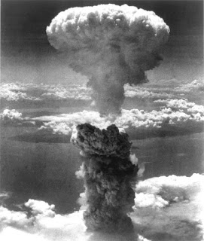
Hiroshima and Nagasaki: A Brief History
World War II
August 6, 1945 world’s first atomic bomb was dropped on Hiroshima, Japan by the United States
Initial blast killed 80,000 people, radiation killed thousands more
August 9, 1945 second A-bomb was dropped on Nagasaki, Japan
40,000 killed in initial blast with many more dying of radiation
Less talked about:
The long term effects of the bomb and its radiation
What were the indirect casualties? Who did they affect? How long did the effects take?
Content: https://www.history.com/topics/world-war-ii/bombing-of-hiroshima-and-nagasaki
Image: http://wavefunction.fieldofscience.com/2017/08/the-bomb-ended-world-war-2-and-other.html

Slide 3
The Data
cancer mortalities in the years between 1950 and 1982 in Hiroshima and Nagasaki
each mortality is documented with the city, sex, age at exposure, radiation dose (centigray), type of cancer, and year of death
Collected and published by the Radiation Effects Research Foundation in Hiroshima, Japan

Slide 4
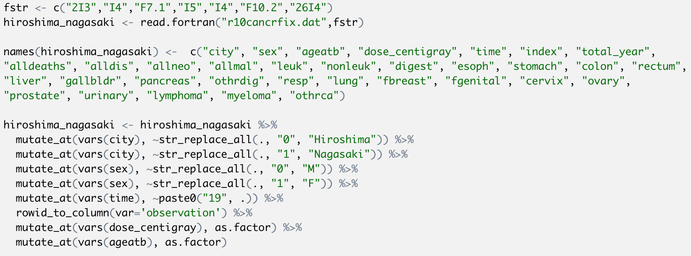
Opening file with Fortran format and cleaning up column names
Opening file with Fortran format and cleaning up column names

Slide 5
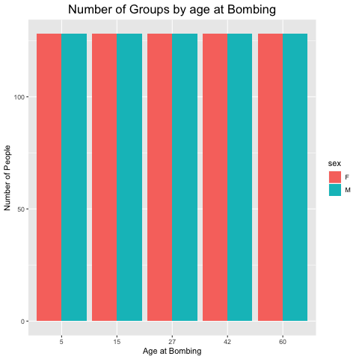
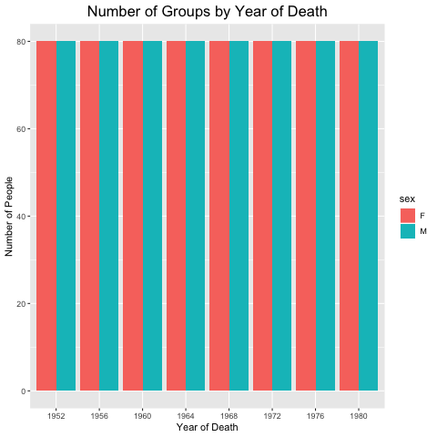
Organization of Data
The number of people recorded across ages, genders, and the year of death are equal

Slide 6
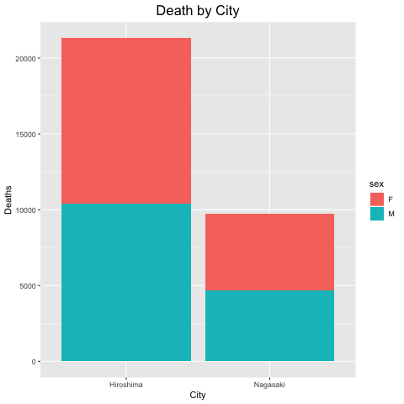
Deaths in Hiroshima more than 2x those in Nagasaki
Population of Hiroshima (1945)
350,000 people
Population of Nagasaki (1945)
240,000 people

Slide 7
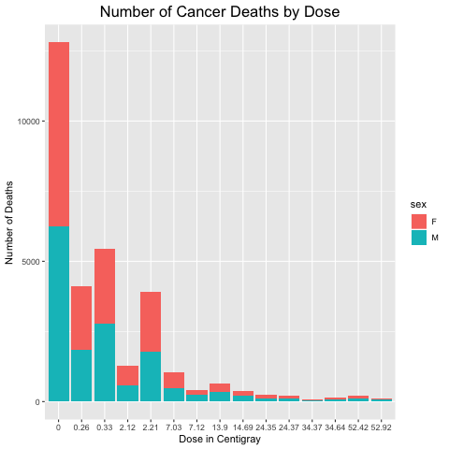
Most deaths occurred among survivors who had a low dose
Not as many survivors who had a high dose

Slide 8
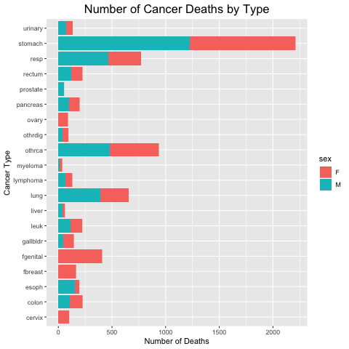
Most deaths were among those with stomach cancer
Japanese people more susceptible to gastritis (inflammation of protective lining of stomach)
Gastritis causes more stomach cancer deaths

Slide 9
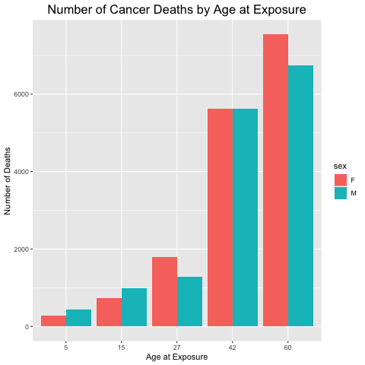
Positive trend between age at exposure and number of deaths

Slide 10
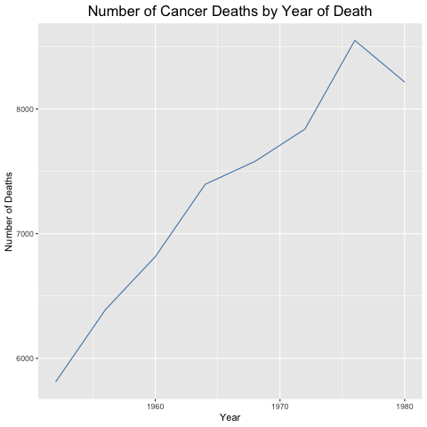
The number of deaths increases as time goes on until 1976

Slide 11
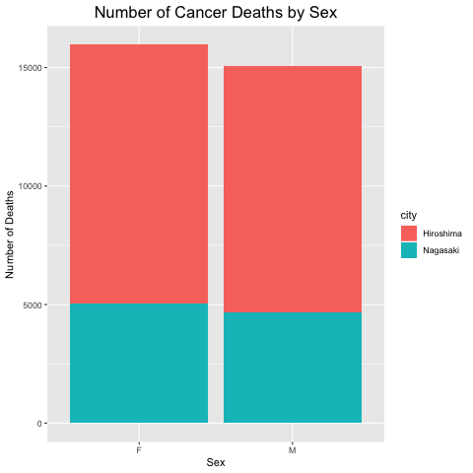
Slightly more female deaths than male (consistent in both cites)
Interesting finding due to the equal numbers of female and male data collected

Slide 12
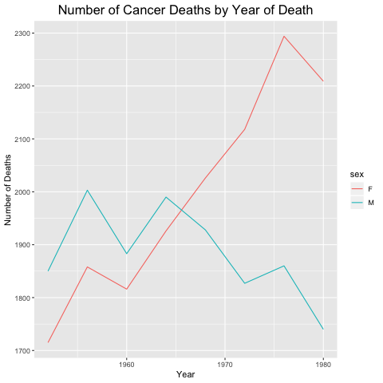
Male deaths fluctuated more than female but decreased sooner and more significantly
Female deaths higher than male and increased each year until 1976

Slide 13
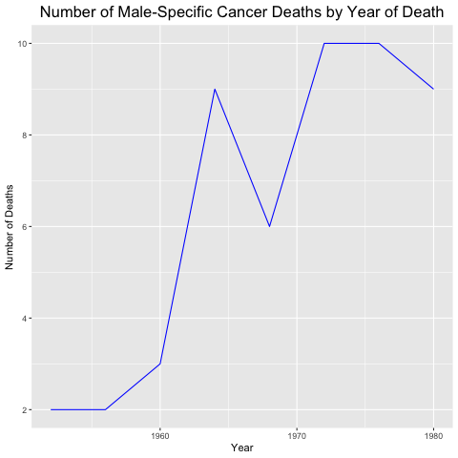
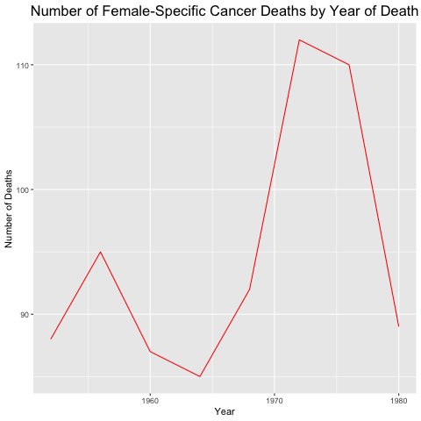

Slide 14
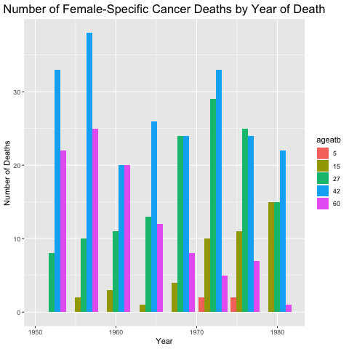
deaths among older females goes down
deaths among younger females goes up

Slide 15
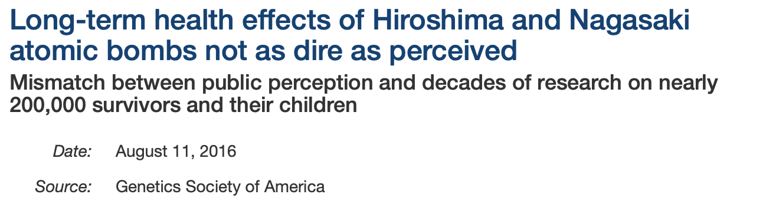
Conclusion
Several trends found: some expected and some unexpected
Data from the 1950’s - 1980’s is still accessible (with some difficulties)
Trends suggest that cancer deaths started to decrease in 1976
Further research suggests children of survivors have no health effects

